Slide 1
Interim 2

Slide 2
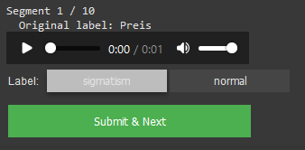
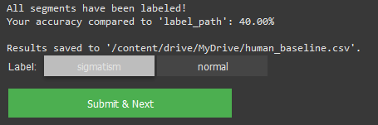
Human Baseline
468 words
All data is saved in a csv for later analysis

Slide 3
Dataset
61 Speaker
61 sigmatism Recordings
61 normal Recordings
57 qualified
4 removed
Assessment by speech therapist
Number of speakers in train: 48, val: 9 test: 4

Slide 4
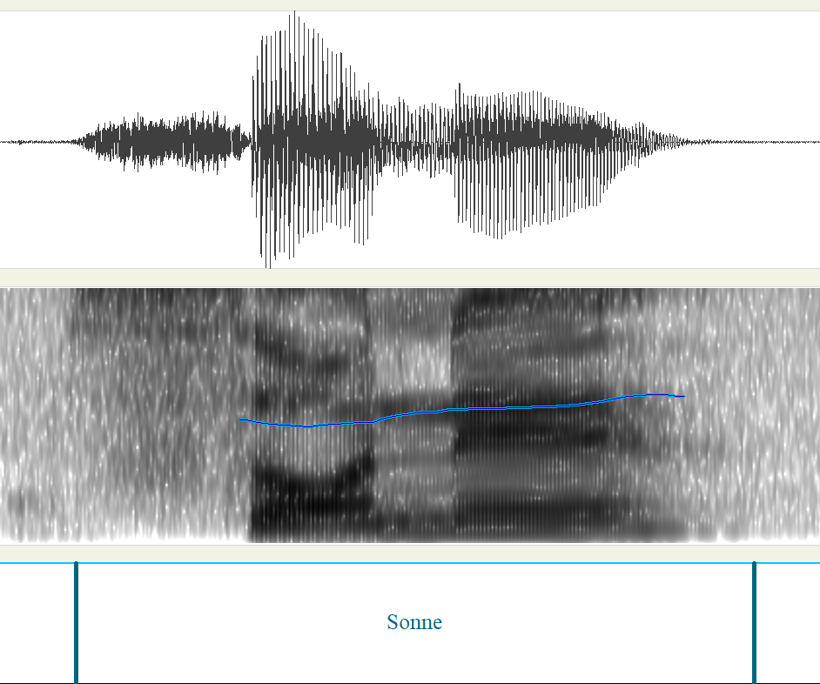
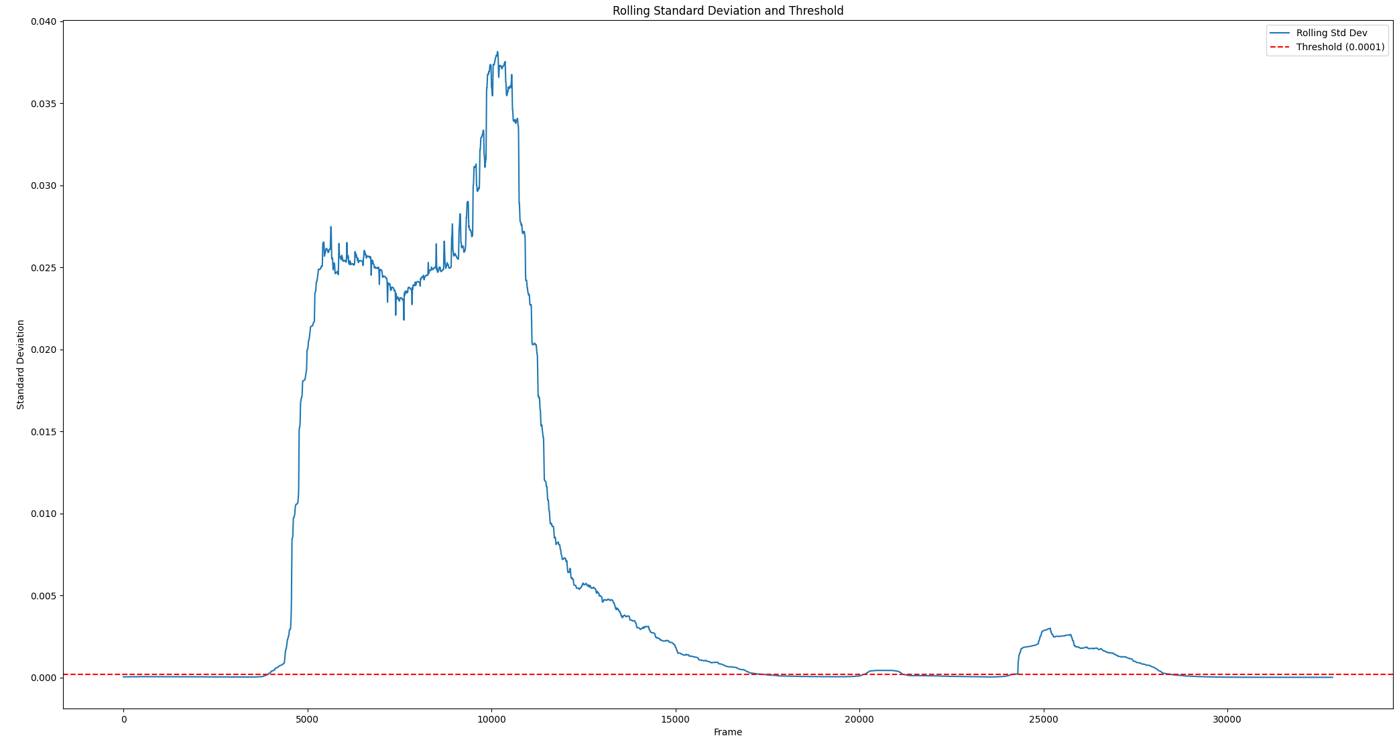
Audio Extraction
Webmouse labels used for rough guidance
Rolling std peformed whith threshold at 0.0002

Slide 5
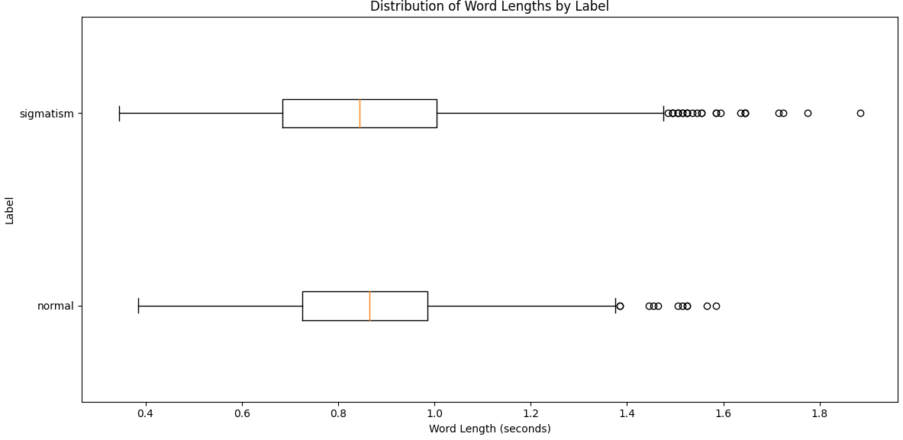
New length of words
Notes:
Man könnte sich noch einen low pass filter überlegen.
Outlier ab 1.5 mal angeschaut. Sind fast alles sigmatismus wörter. Aussprache teilweise sehr betont.

Slide 6
Normalization
Till now [-1,1] (Peak) Normalization but has some flaws
Use Mean-and-Variance Normalization per speaker (z-score)
Got global mean and std from training split
Applied that to each wav file for CPP,FAD.
- For MFCC and Mel specto, STT-CNN:
Normalize only image with z-score. Avoid double normalization?
The STT takes the raw waveform
Notes:
[-1,1] (Peak) Normalization doesn not stabilize mean and variance
limiting to [−1,1] helps avoid clipping in fixed-point systems. But in deep learning it’s fine to have values outside [−1,1]
Potentially Harms Gradient Descent

Slide 7
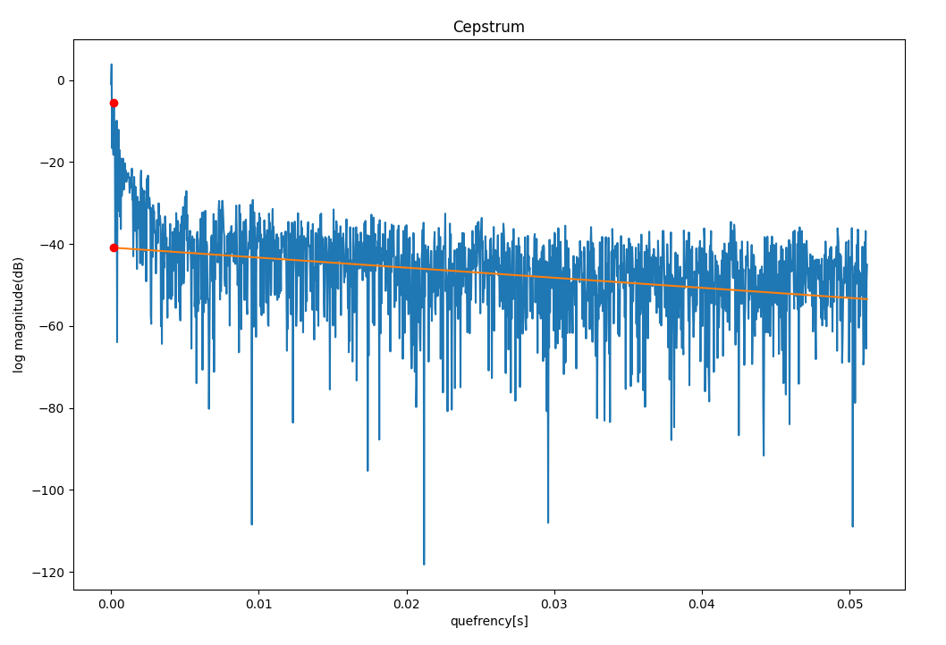
CPP – 16kHz
trendline_quefrency_range=[0.001, 0.05]

Slide 8
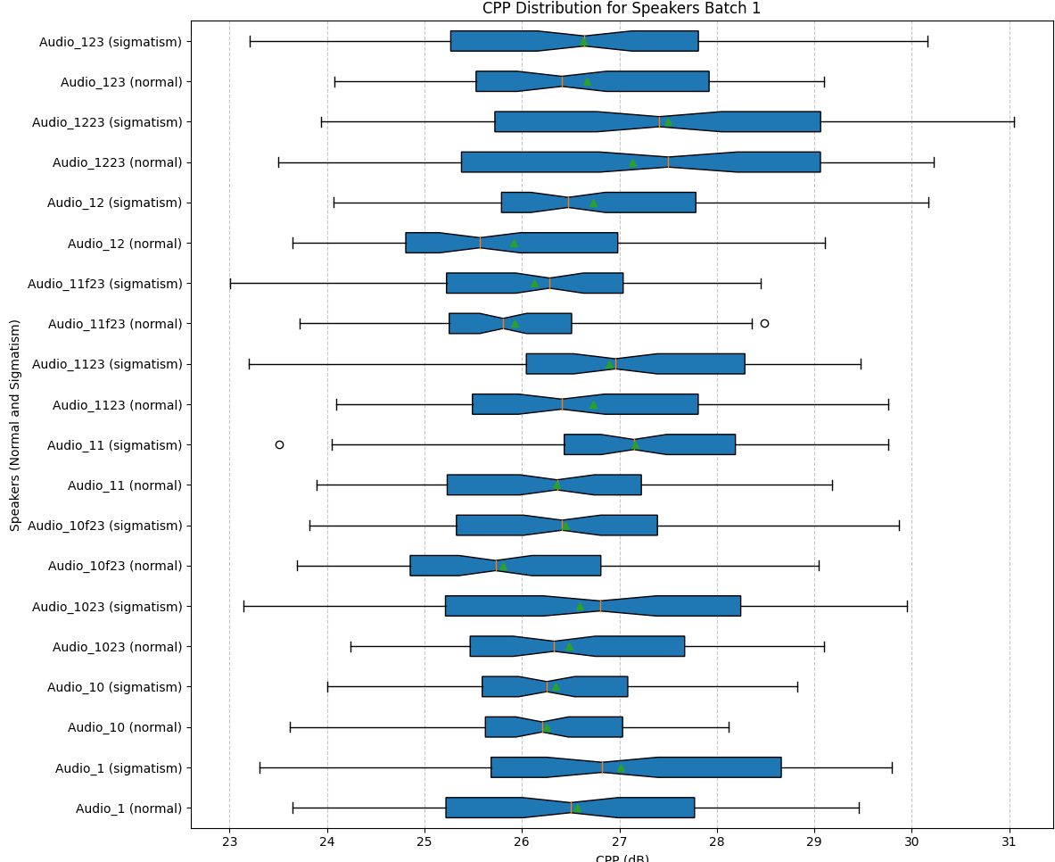
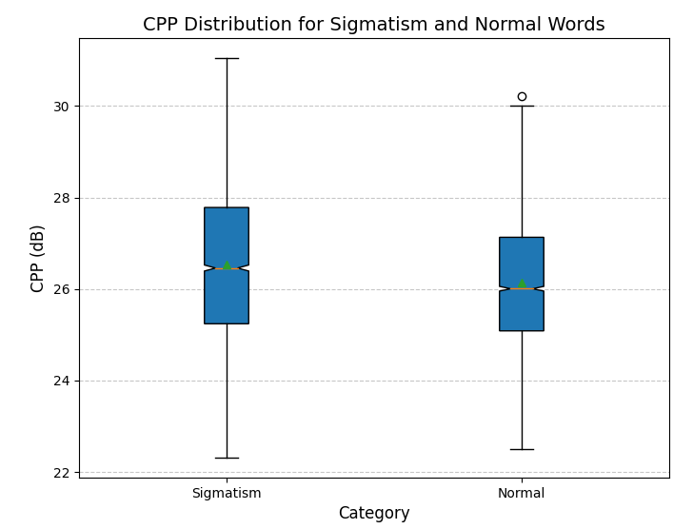
pitch_range=[60, 1000]HZ,
Notes:
the trendline quefrency range is the range of the cepstrum over which you fit a linear regression (or trend line) to model the overall slope of the cepstrum.

Slide 9
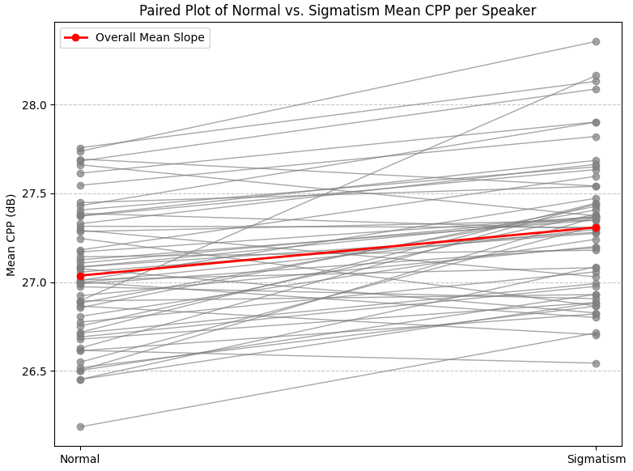
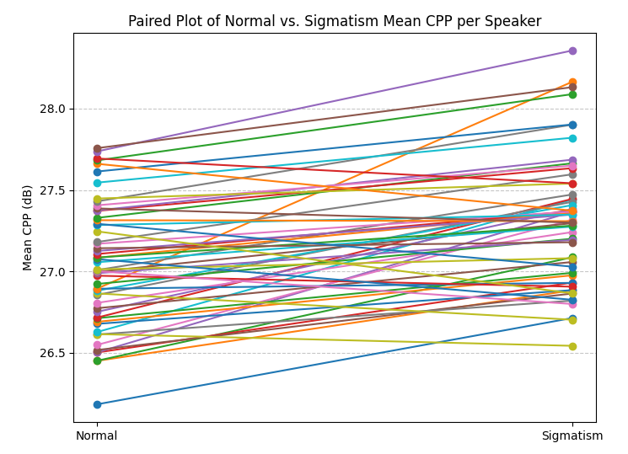
Paired T-test
pitch_range=[60, 1000],

Slide 10
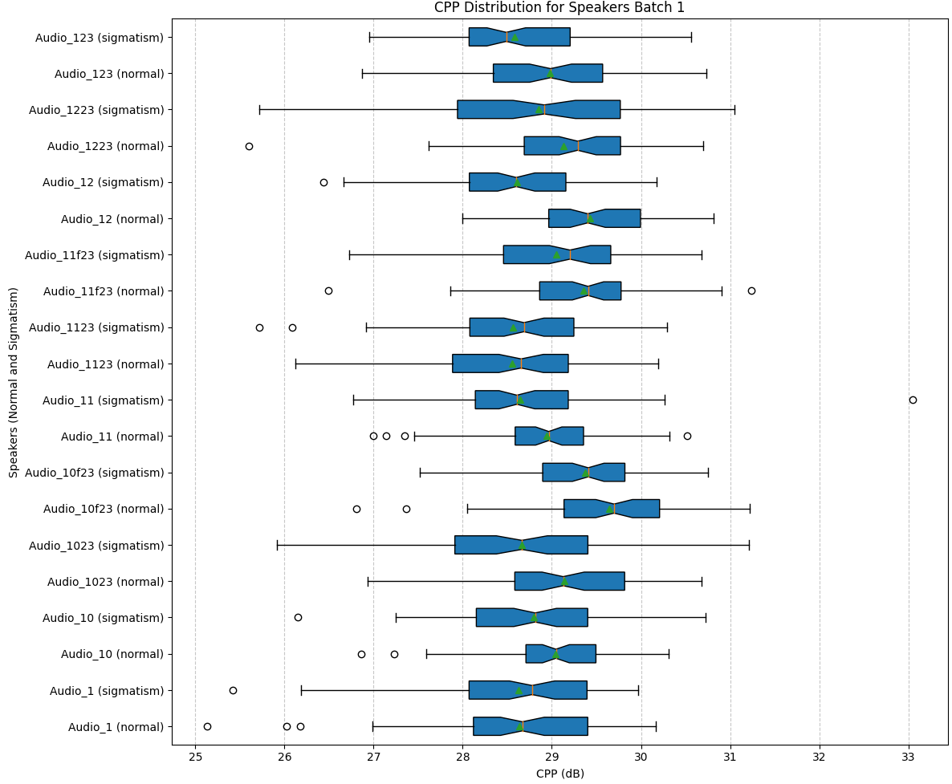
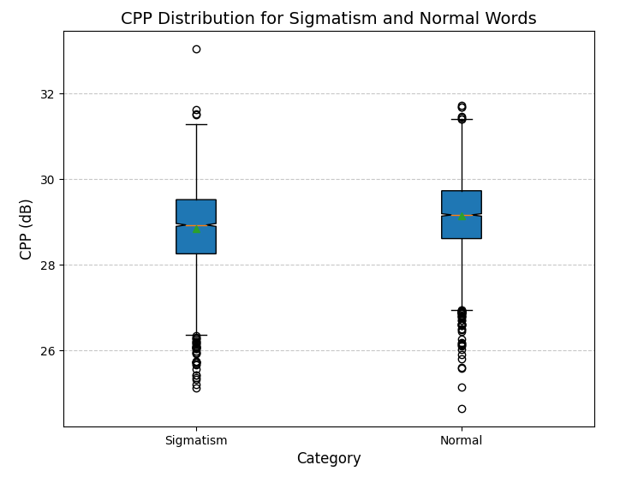
pitch_range=[60, 8000],

Slide 11
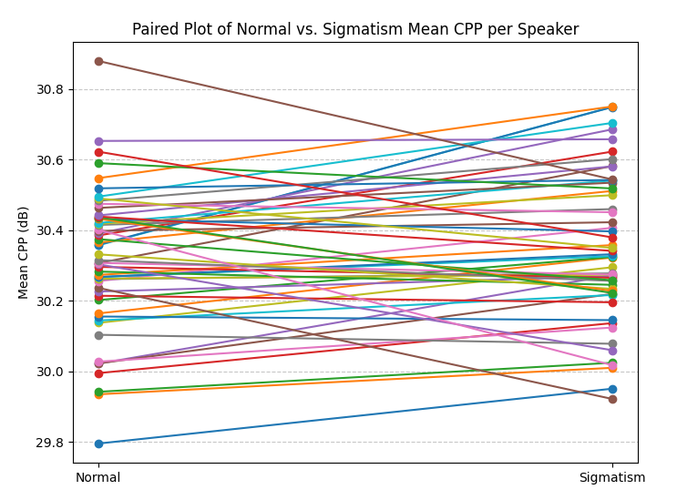
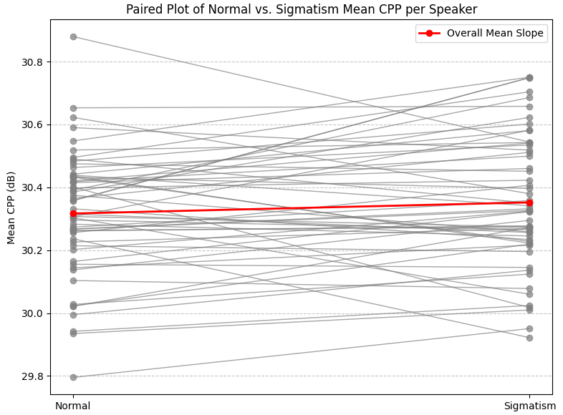
Paired T-test
pitch_range=[60, 8000],

Slide 12
FID/FAD
The FAD model is the same as before because it takes the raw audio folder: FAD score with model: 0.278
Compute mean and cov
FID = ||mu1 - mu2||^2 + Tr(sigma1 + sigma2 - 2 * sqrt(sigma1 * sigma2))
mu1, sigma1 : Mean vector and covariance of word 1
mu2, sigma2 : Mean vector and covariance of word 2
Was done for every word because cov otherwise too big.

Slide 13
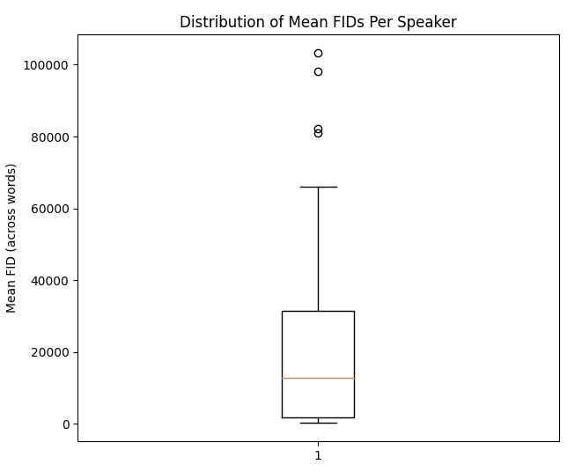
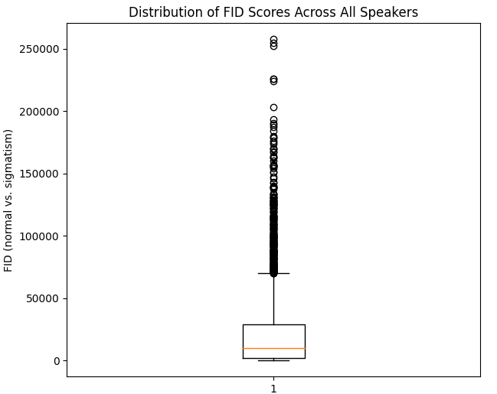

Slide 14
STT model
16kHz non normalized word segments used
ß was changed to s
Only if s,x or z are present in a word the AuC is computed

Slide 15
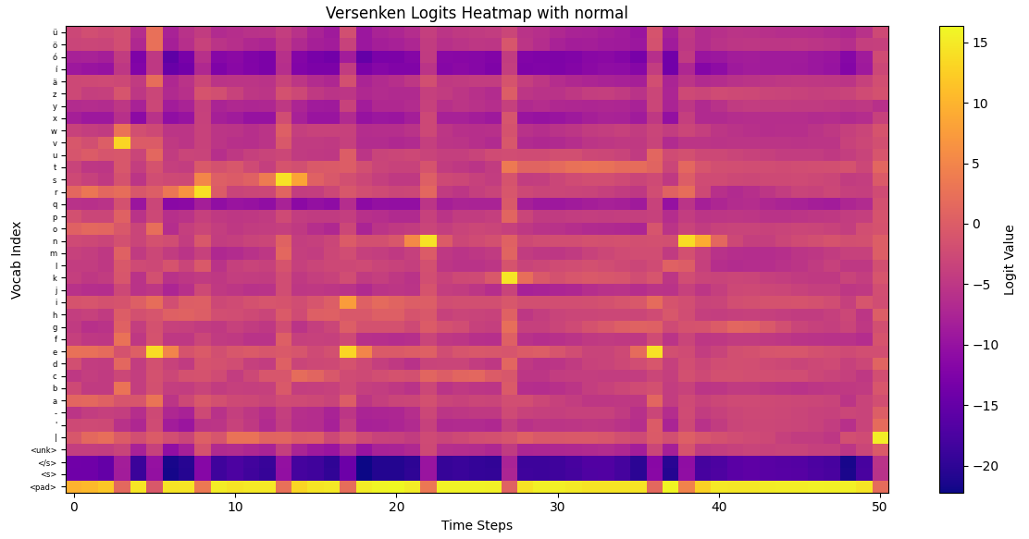
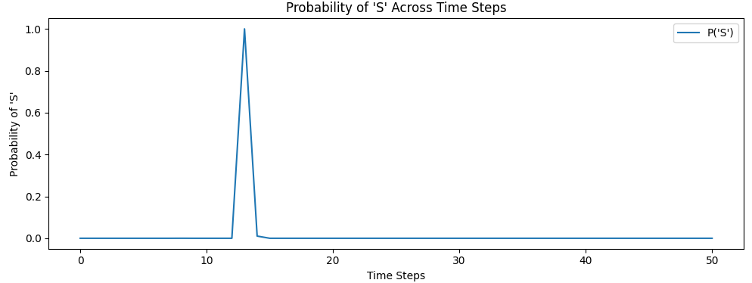
Reference: Versenken
Prediction: ['versenken’]
normal

Slide 16
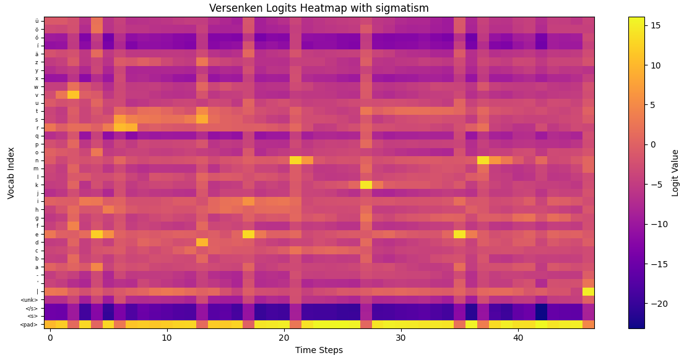
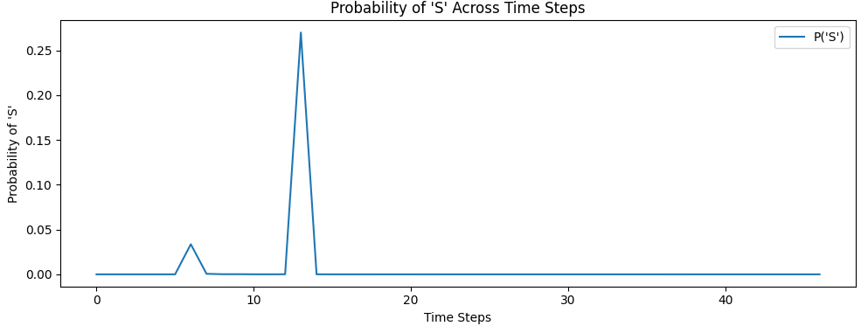
Reference: Versenken
Prediction: ['verdenken’]
sigmatism

Slide 17
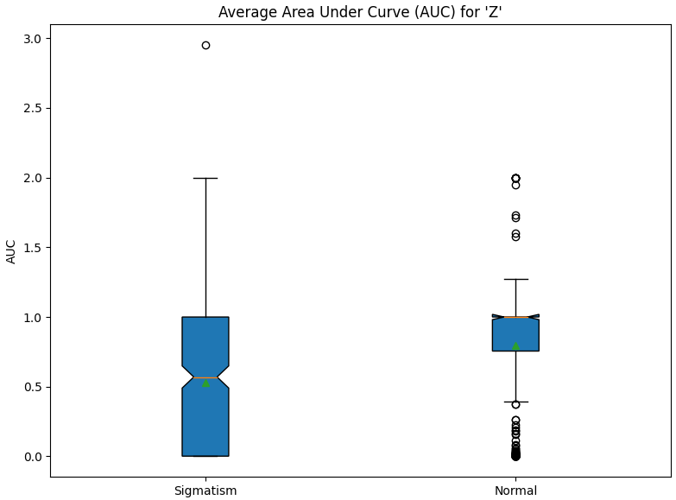
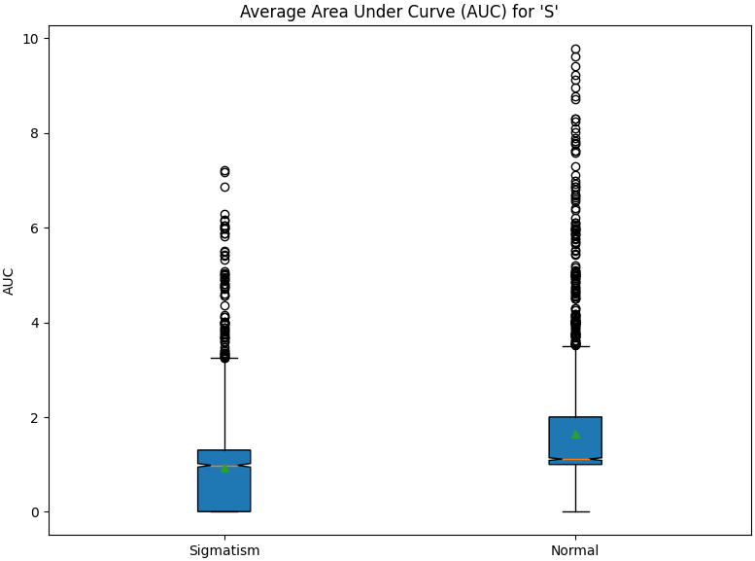
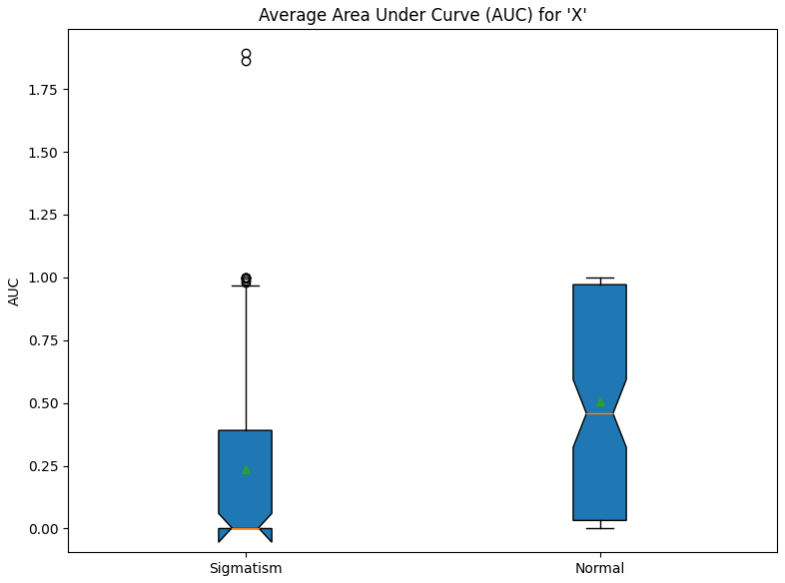

Slide 18
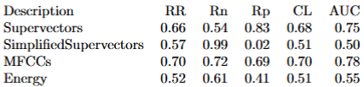
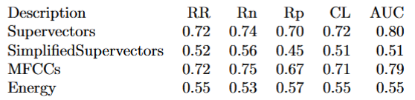
Valentini Paper – On the big dataset
SVM used for calssification
AdaBoost used for calssification

Slide 19
Next Steps:
Hyperparamtuning for MFCC, Mel-Specto, Attention 1 &2
How to make fixed lists? How often what and how many times augmented?
Should i do random Crop/pad on audio?
Should i do any augmentations on the images?
Hyperparam training for STT approach.
Only take rows of s,x,z? -> small input?
Any augmentations?
How to resize?
First pad till longest word in time axis. Then interpolate in both axis.
Do that for STT, MFCC, Mel Specto?
Notes:
Noise
Time strecht
Pitch shifting
Crop /pad

